Slide 1

DETECHTIVE
The Batcomputer: Bayesian Network Mystery Solver
GROUP #8
MD. MRAN NOOR EMON | SHAFKAT SHARIF BHUIYAN | NUDAR NAWAL HOSSAIN

Slide 2


THE DETECTIVE'S DILEMMA
INFORMATION OVERLOAD
•
Crime scenes in Gotham generate massive amounts of conflicting data.
•
Human intuition is prone to bias and error.
•
Goal: Create a system that calculates the mathematical probability of guilt based on evidence.
GROUP #8
MD. MRAN NOOR EMON | SHAFKAT SHARIF BHUIYAN | NUDAR NAWAL HOSSAIN

Slide 3






DUAL-STACK ARCHITECTURE
THE GATEWAY
THE SOLVER
THE BRAIN
REDIRECTS TO
Python Backend
Bayesian Logic (pgmpy)
Dynamic JSON Data
React Frontend
Secure Login/Signup
Modern UX (Vite + Tailwind)
Streamlit App
Interactive Evidence Log
Real-time Visualization
GROUP #8
MD. MRAN NOOR EMON | SHAFKAT SHARIF BHUIYAN | NUDAR NAWAL HOSSAIN

Slide 4
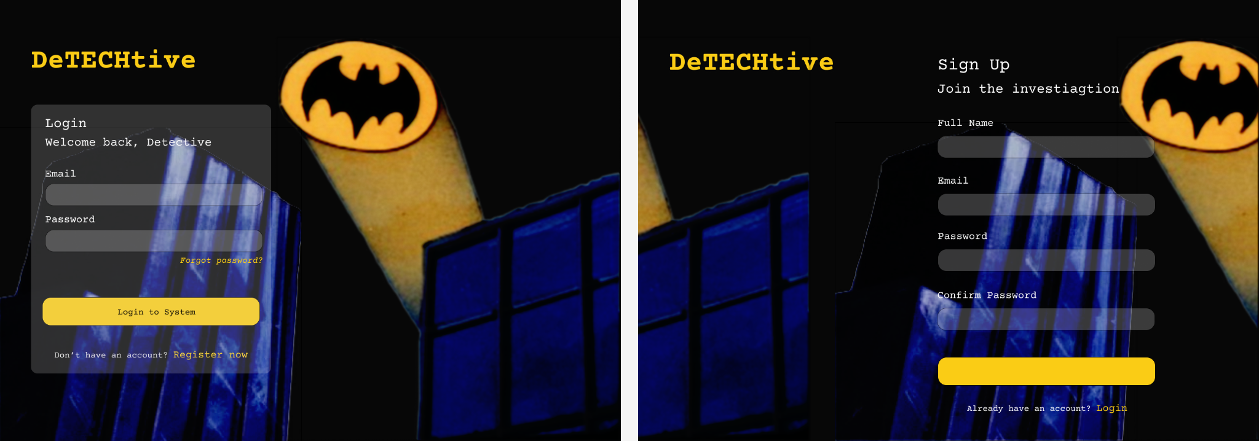
THE PORTAL: FRONTEND INTERFACE
GROUP #8
MD. MRAN NOOR EMON | SHAFKAT SHARIF BHUIYAN | NUDAR NAWAL HOSSAIN

Slide 5
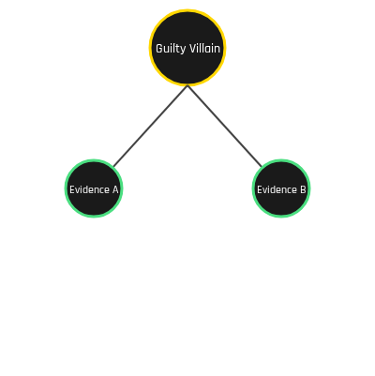
THE LOGIC CORE: BAYESIAN NETWORKS
DYNAMIC GENERATION
We don't hardcode rules. We load `gotham_mysteries.json`.
Factory Pattern: `create_mystery_model()` builds the network on the fly.
Inference: Uses Variable Elimination to calculate posterior probability:
P(Guilt | Evidence)
Scalable: Adding a new case is as simple as editing a text file.
GROUP #8
MD. MRAN NOOR EMON | SHAFKAT SHARIF BHUIYAN | NUDAR NAWAL HOSSAIN

Slide 6


TECHNOLOGY STACK
Languages: Python (Logic), TypeScript (Frontend)
Frameworks: Streamlit (Solver UI), React + Vite (Auth UI)
Libraries: pgmpy (Bayesian Math), Graphviz (Visualization), Pandas (Data)
Styling: Tailwind CSS (Frontend), Custom CSS (Streamlit)
GROUP #8
MD. MRAN NOOR EMON | SHAFKAT SHARIF BHUIYAN | NUDAR NAWAL HOSSAIN

Slide 7
PROJECT IMPACT
12+
100%
<1s
Playable Scenarios
Data Driven
Inference Time
Conclusion: We successfully bridged modern web tech (React) with data science tools (Python) to create an engaging, scalable educational tool.
GROUP #8
MD. MRAN NOOR EMON | SHAFKAT SHARIF BHUIYAN | NUDAR NAWAL HOSSAIN

Slide 8






FUTURE WORK
MOBILE APP
LLM INTEGRATION
MULTIPLAYER
Porting the React frontend to React Native for investigation on the go.
Competitions to see who can solve the mystery with the fewest clues.
Using further comic research to generate infinite random mysteries into the JSON file.
GROUP #8
MD. MRAN NOOR EMON | SHAFKAT SHARIF BHUIYAN | NUDAR NAWAL HOSSAIN

Slide 9

TO THE BATCAVE
Code Walkthrough & Live Demo Video
https://github.com/Emran-Emon/DeTechtive
GROUP #8
MD. MRAN NOOR EMON | SHAFKAT SHARIF BHUIYAN | NUDAR NAWAL HOSSAIN

